Slide 1
Clinical consequences of immune cell dysfunction in upper and lower airway disease: the role of epithelial cytokines
Developed in collaboration with Dr Anne K Ellis
Specialist in Allergy and Immunology, Queen’s University, Kingston, Canada

Slide 2

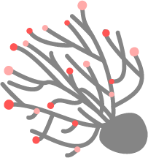

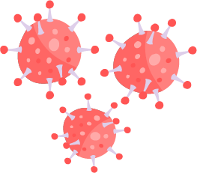




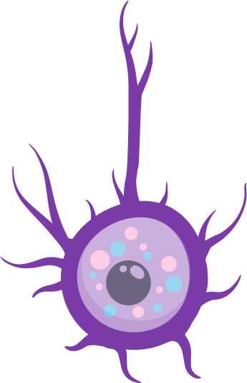

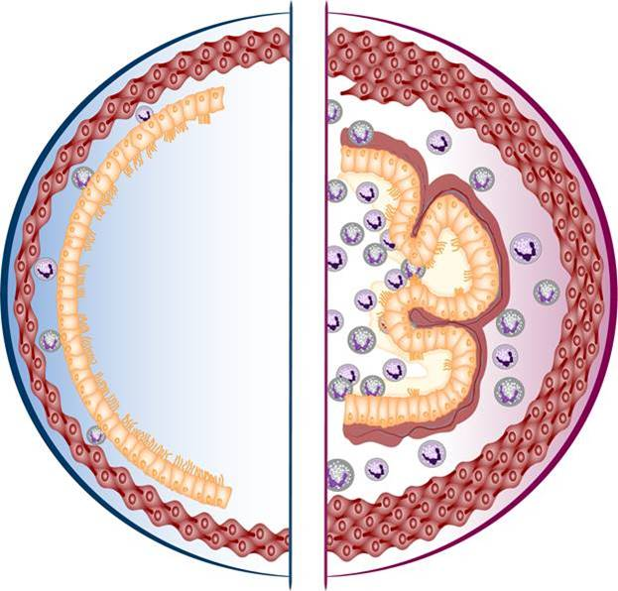
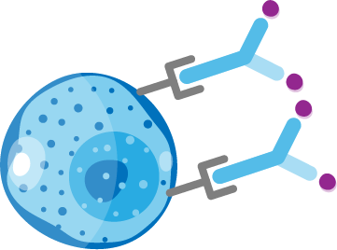
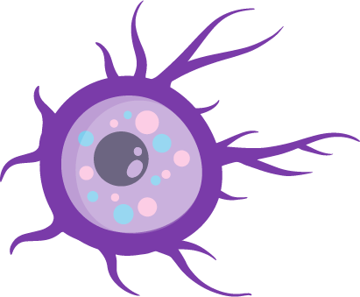
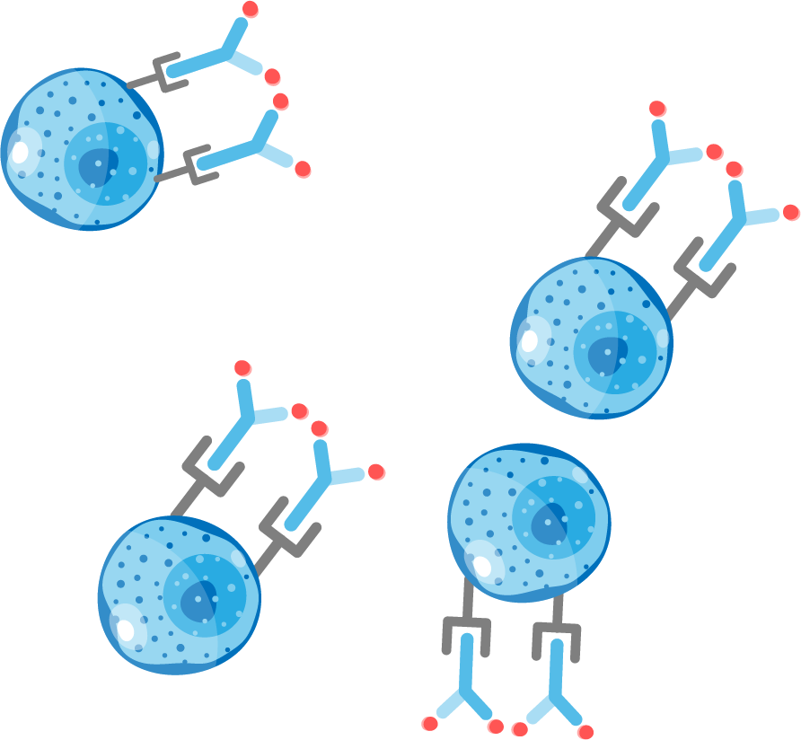



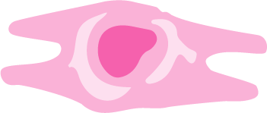
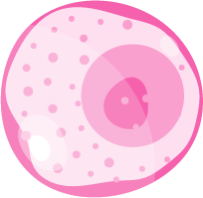

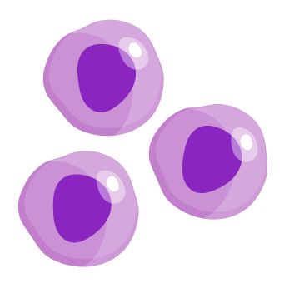



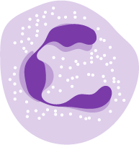
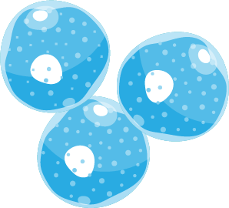
In asthma, epithelial cytokines are thought to drive allergic and eosinophilic inflammation and T2-independent effects from the top of the cascade
Triggers
Allergens
Cytokines
Fungi
Bacteria
Viruses
Smoke
Pollution
Epithelium
Mucus
Airway
TSLP
IL-33
TSLP
IL-33
IL-25
TSLP
IL-33
IL-25
TSLP
Goblet cell
IL-5
IL-13
Mast cells
Collagen
Basophil
Dendritic cell
Mucus
Naïve
T cell
IL-13
IL-13
TSLP
ILC2s
Histamine
Leukotrienes
IL-4, IL-13
Th2
cells
TSLP
Fibroblast
IL-5
IL-5
IgE
ILC2s
Mast cells
IL-4, IL-13
Eosinophils
B cells
IL-13
TSLP
IL-6
IL-13
IL-13
Smooth muscle
Allergic eosinophilic
Non-allergic eosinophilic
Beyond T2 pathways
Mechanisms underlying non-eosinophilic inflammation in asthma and the relevance of TSLP in its potential effects on macrophages both require further elucidation. The information presented in this image has been simplified for illustration purposes only and does not imply clinical benefit or relevance
Figure adapted from Porsbjerg CM, et al. Eur Respir J 2020;56:2000260 and Gauvreau GM, et al. Expert Opin Ther Targets 2020;24:777–792, which was based on Brusselle G, Bracke K. Ann Am Thorac Soc 2014;11(Suppl. 5):S322–S328; Brusselle GG, et al. Nat Med 2013;19:977–979 and Lambrecht BN, Hammad H. Nat Immunol 2015;16:45–56
IgE, immunoglobulin E; IL, interleukin; ILC2, type 2 innate lymphoid cell; T2, type 2; Th, T helper; TSLP, thymic stromal lymphopoietin
1. Gauvreau GM, et al. Expert Opin Ther Targets 2020;24:777–792; 2. Porsbjerg CM, et al. Eur Respir J 2020;56:2000260; 3. Roan F, et al. J Clin Invest 2019;129:1441–1451; 4. Varricchi G, et al. Front Immunol 2018;9:1595; 5. Altman MC, et al. J Clin Invest 2019;129:4979–4991; 6. Allakhverdi Z, et al. J Exp Med 2007;204:253–258; 7. Kato A, et al. J Immunol 2007;179:1080–1087; 8. Kouzaki H, et al. J Immunol 2009;183:1427–1434; 9. Lee H-C, Ziegler SF. Proc Natl Acad Sci U S A 2007;104:914–919; 10. Semlali A, et al. J Allergy Clin Immunol 2010;125:844–850; 11. Brightling CE, et al. N Engl J Med 2021;385:1669–1679

Slide 3
Similar inflammatory processes are associated with both upper and lower airways diseases^{1–3}
Inflammation in upper airways disease
Allergens
Cytokines
Fungi
Bacteria
Viruses
Smoke
Pollution
Inflammation in asthma
Triggers
Viruses
Bacteria
Allergens
Cytokines
Fungi
Bacteria
Viruses
Smoke
Pollution
Mucus
Epithelium
Mucus
TSLP
IL-33
TSLP
IL-33
IL-25
TSLP
IL-33
IL-25
TSLP
Goblet cell
IL-5
IL-13
TSLP
IL-33
TSLP
IL-33
IL-25
TSLP
IL-33
IL-25
TSLP
Goblet cell
IL-5
IL-13
Mast cells
Collagen
Basophil
Dendritic cell
Mucus
Collagen
Mast cells
Naïve
T cell
Mucus
IL-13
IL-18
Dendritic cell
Dendritic cell
Dendritic cell
TSLP
Basophil
IL-13
ILC2s
IL-12
Naïve
T cell
IL-13
IL-13
Histamine
Leukotrienes
TSLP
Th2
cells
ILC2s
Fibroblast
IL-18
IL-4, IL-13
IL-5
IL-5
TSLP
ILC3s
IL-17
IL-22
Histamine
Leukotrienes
IgE
IL-4, IL-13
Th2
cells
TSLP
Fibroblast
IL-4, IL-13
IL-5
IL-5
Mast cells
ILC1s
IgE
IL-4, IL-13
Eosinophils
Mast cells
IFN-γ
TNF-α
B cells
IL-13
TSLP
IL-6
Th1 cell
Th17 cell
NK
B cells
IL-13
IL-13
Eosinophils
IL-13
Smooth muscle
IL-13
IL-13
Smooth muscle
TSLP
IL-6
Neutrophil
Macrophage
Type 1
Type 2
Beyond Type 2
Type 3

Slide 4
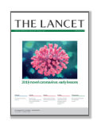
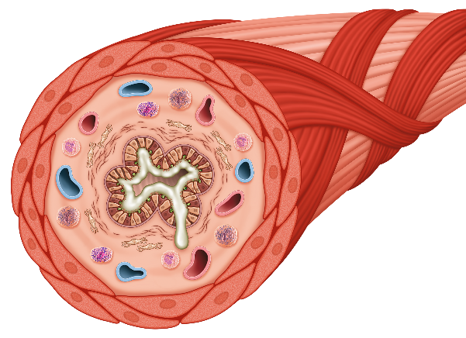
Eosinophilic inflammation is central to the key pathological features and clinical consequences of asthma
“Studies support a crucial role for eosinophils as drivers of type 2 immune-inflammatory responses in asthma”¹
Micheal C Peters, Sally E Wenzel
Asthma airway pathology
Clinical consequences
Eosinophil-rich airway inflammation (Type 2)^{1,2}
Exacerbations²
Airway obstruction² (eg ↓ lung function)
Epithelial damage^{1,3}
Eosinophil activation
Goblet cell hyperplasia⁴
Airway hyperresponsiveness²
Mucus production²
Smooth muscle contractility
and hypertrophy²
Airway remodelling²
1. Peters MC, Wenzel SE. Lancet 2020;395;371–383; 2. Israel E, Reddel HK. N Engl J Med 2017;377:965–976; 3. Gandhi NA, et al. Nat Rev Drug Discov 2016;15:35–50; 4. McBrien CN, Menzies-Gow A. Front Med (Lausanne) 2017;4:93; 5. Diver S, et al. Lancet Repir Med 2021;9:1299–1312
Notes:
Direct lift from ML-3034-ALL-0062 slide 10 except I deleted the hyperlink to another slide in the bottom right corner of this slide

Slide 5
Allergic rhinitis: epidemiology and immune response
Early phase of allergy (minutes)
Late phase of allergy
(maximal at 6–9 hours)
Affects approximately 18% of the global population^{1a}
Often associated with asthma, atopic dermatitis and food allergy^{2,3}
80% of patients with allergic asthma
also have allergic rhinitis⁴
Impacts quality of life, sleep, work²
Consists of an early phase (mainly mast
cell mediated)² and a late phase (mainly eosinophil mediated)⁵
Eosinophil
Basophil
Mast cell
IL-5
Cytotoxic molecules
Major basic protein; eosinophil peroxidase
Mast cells
Recruitment Th2 cells; activation of eosinophils
Mast cell degranulation
More eosinophil
progenitors
Activation of neutrophils
Epithelial /
tissue damage;
AHR
Class switching of plasma cells – IgE
ª literature review on rhinitis prevalence was performed using PubMed and Scopus; 184 studies were included in the qualitative analysis
IgE, immunoglobulin E; IL, interleukin; PRG2, proteoglycan 2; Th, T helper
Figure informed by Akkoc T, et al. Allergy Asthma Immunol Res. 2011;3(1):11–20; Davoine F, Lacy P. Front Immunol 2014;5:570; Galli SJ, et al. Nature 2008;454:445–454; McBrien CN, Menzies-Gow A. Front Med (Lausanne) 2017;4:93; Pawankar R, et al. Asia Pac Allergy 2011;1:157–167; Ramirez GA, et al. Biomed Res Int 2018;2018:9095275
1. Savouré M, et al. Clin Transl Allergy 2022;12:e12130; 2. Pawankar R, et al. Asia Pac Allergy 2011;1:157–167; 3. Nur Husna SM, et al. Front Med (Lausanne) 2022;9:874114;
4. Egan M, Bunyavanich S. Asthma Res Pract 2015;1:8; 5. Zoabi Y, et al. Biomedicines 2022;10:2486.

Slide 6
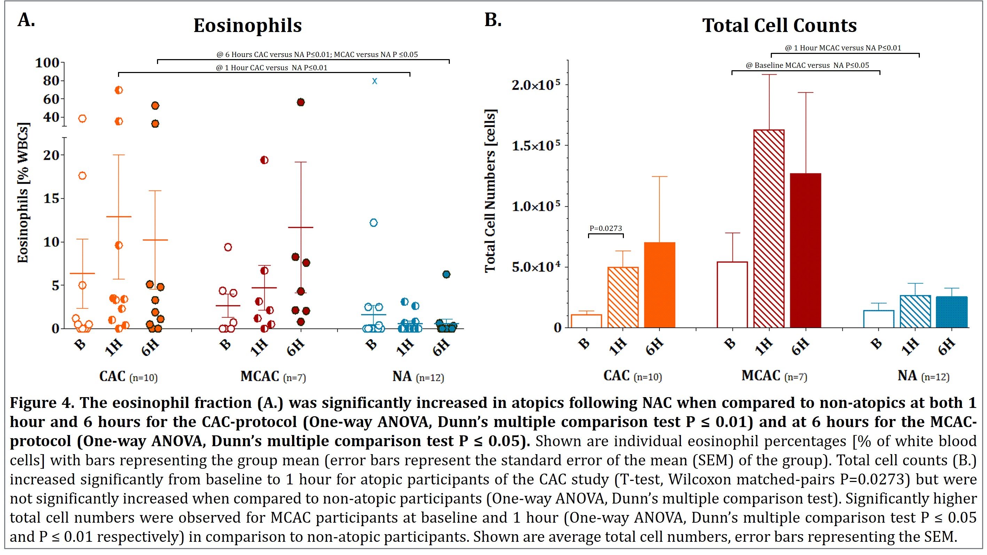
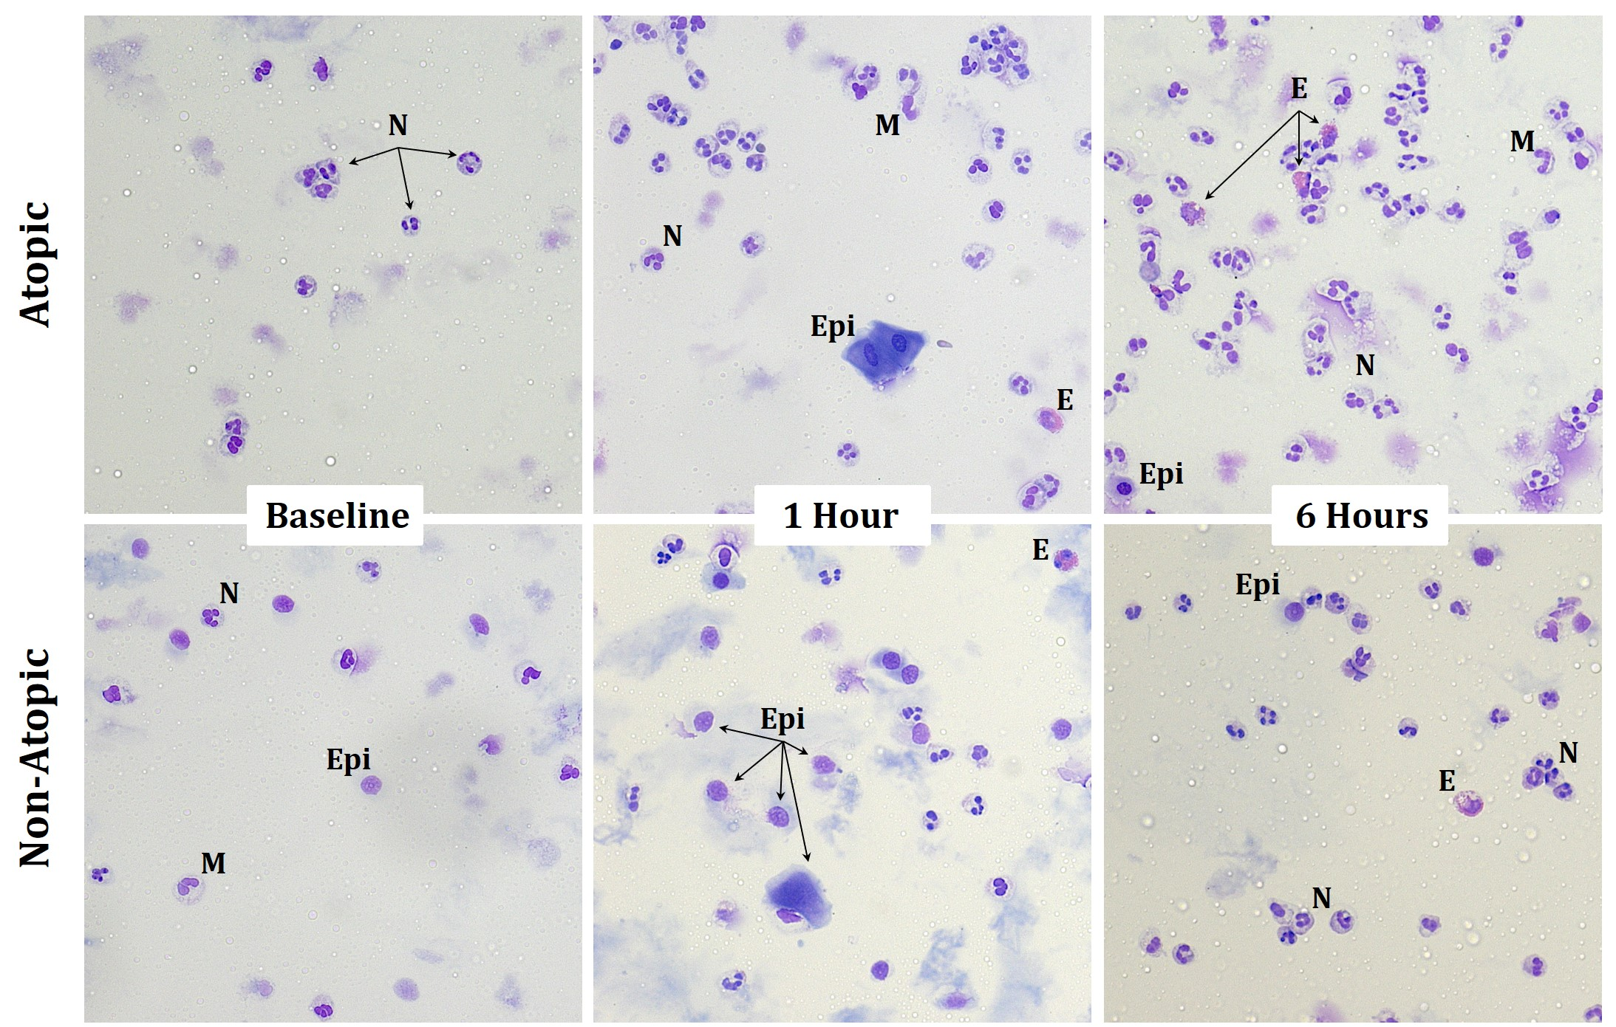
Eosinophilia is increased in atopic patients following NAC
CAC, cumulative allergen concentration; E, eosinophils; Epi, epithelial cells; M, monocytes; MCAC, multiple cumulative allergen concentration; N, neutrophils; NA, non-atopic participants; NAC, nasal allergen challenge; WBC, white blood cell
Presenter’s own data presented at CSACI 2015

Slide 7
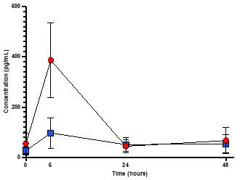
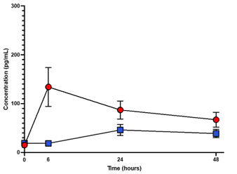
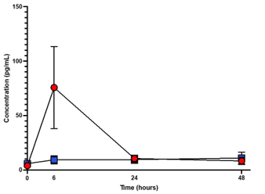
Cytokines are elevated in allergic patients compared with non-allergic patients 6 hours post-NAC
IL-4 increased
IL-5 increased
IL-13 increased
600
300
150
400
200
100
Concentration (pg/ml)
Concentration (pg/ml)
Concentration (pg/ml)
Concentration (pg/ml)
200
100
50
0
0
0
0
6
24
48
0
6
24
48
0
6
24
48
Time (hours)
Time (hours)
Time (hours)
Time (hours)
Allergic
Non-allergic
IL, interleukin; NAC, nasal allergen challenge
Presenter’s own data.

Slide 8

CRSwNP is frequently associated with asthma
A bi-directional relationship between upper and lower airway disease exists;
patients with CRSwNP have an increased risk of developing asthma, and vice versa⁶
This co-existence suggests a common pathophysiology and has led to the concept of united airway disease⁷
CRSwNP is more commonly associated with severe asthma than mild asthma^{3*}
Even in the absence of asthma, the severity of CRSwNP is associated with decreased lung function⁴
Asthma in the presence of nasal polyps is also more difficult to control^{2,5}
Approximately
40–67% of patients
with CRSwNP have
comorbid asthma²
Patients diagnosed with CRSwNP
and asthma have a greater burden of disease than those without asthma^{1,2}
Polyp recurrence following surgery
is more frequent in patients with comorbid asthma¹
*Patients (n= 492) with asthma were recruited into this cross-sectional multicentre study from 23 pulmonology and ENT clinics; asthma severity, control and upper airway comorbidities were assessed according to international consensus guideline definitions
CRSwNP, chronic rhinosinusitis with nasal polyps; ENT, ear, nose and throat.
1. Bachert C, et al. J Asthma Allergy 2021;14:127–134; 2. Laidlaw TM, et al. J Allergy Clin Immunol Pract 2021;9:1133–1141; 3. Castillo JA, et al. J Allergy Clin Immunol Global 2023;2:100134;
4. Du K, et al. Clin Exp Allergy 2020;50:1362–1371; 5. Toppila-Salmi S, et al. Clin Transl Allergy 2022;12:e12200; 6. Ryu G, et al. Sci Rep 2020;10:9589; 7. De Corso E, et al. J Pers Med 2022;12:846

Slide 9


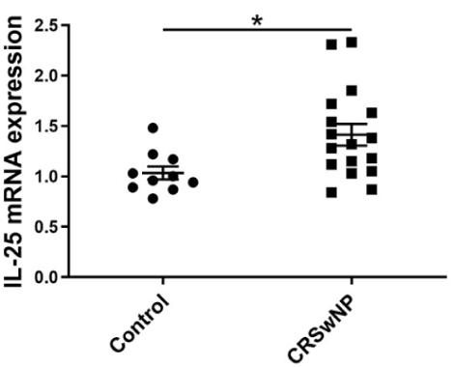
Expression of TSLP, IL-25 and IL-33 are elevated in CRSwNP
TSLP, IL-25 and IL-33 are elevated in cells from patients with CRSwNP^{1–9}
TSLP levels are higher in nasal polyp
tissues compared with uncinate process
tissues of the same patients with CRSwNP¹⁰
IL-25 levels are elevated in nasal epithelial cells
of patients with CRSwNP, compared with those
of control subjects^{4a}
Levels of IL-33 are increased in uncinate process tissues from patients with CRSwNP compared with control subjects⁹
10
Uncinate process tissue
2
**
Nasal polyp
***
P<0.01
**
7.5
1
TSLP relative to GAPDH
(ratio to control)^{b}
IL-33/total protein (ng/mg)
5
2.5
0
Control
-UP
CRSsNP
-UP
CRSwNP
-UP
NP
0
ª Control subjects (n=10) and CRSwNP (n=17); ^{b} Values represent the ratio to control (uncinate process tissue from patients with allergic rhinitis)¹⁰
Figure adapted from Liu R, et al. Front Immunol 2021;12:530488. Licensed under CC-BY 4.0 from: https://creativecommons.org/licenses/by/4.0/ (Accessed 15 May 2023)
CRSwNP, chronic rhinosinusitis with nasal polyps; CRSsNP, chronic rhinosinusitis without nasal polyps; GAPDH, glyceraldehyde 3-phosphate dehydrogenase; IL, interleukin; mRNA, messenger ribonucleic acid; TSLP, thymic stromal lymphopoietin; UP, uncinate process
1. Deng H, et al. J Asthma Allergy 2021;14:839–850; 2. Dogan M, et al. Eur Arch Otorhinolaryngol 2019;276:1685–1691; 3. Workman AD, et al. Int Forum Allergy Rhinol 2019;9:776–786; 4. Liu R, et al.
Front Immunol 2021;12:530488; 5. Nagarkar DR, et al. J Allergy Clin Immunol 2013;132:593–600; 6. Wang B-F, et al. J Allergy Clin Immunol 2023;151(5):1379–1390.e11; 7. Shin S-H, et al. Int J Mol Sci 2020;21:2693; 8. Nagata Y, et al. Am J Rhinol Allergy 2019;33:378–387; 9. Kim D-K, et al. Thorax 2017;72:635–645; 10. Kobayashi Y, et al. Biomolecules 2020;10:326

Slide 10
Summary
Epithelial cytokines play a pivotal role in driving allergic and asthmatic disease processes^{1–3}
Enhanced understanding of mast cell and epithelial mediators will drive better control
of comorbid disease^{1,3,4}
Nasal epithelium is often the first point of contact for allergens, pollutants and viruses⁵
Allergists thus provide a unique role in the management of patients with severe asthma⁶
1. Yii AC, et al. Allergy 2018;73:1964–1978; 2. Laulajainen-Hongisto A, et al. Front Cell Dev Biol 2020;8:204; 3. Fokkens W, Reitsma S. Otolaryngol Clin North Am 2023;56:1–10; 4. De Corso E, et al. J Pers Med 2022;12:846; 5. Zhang R, et al. Int Arch Allergy Immunol 2023;184; 6. Presenter’s opinion

